Slide 1
Data analytics career accelerator 2023 cohort 2 Course 1 Assignment: Exploratory analysis and presenting insights
Student name: Rose Ryan
Submission date: 29 June 2023

Slide 2

Background and context
This analysis will help gain information on customers’ purchase behaviour, based on:
marital status
age
education level
households with children or teenagers
spending habits (popularity of products)
social media referrals for online purchases
The goal of taking this approach is to:
improve online marketing
understand which product categories sell best in which country
ultimately to improve the supply chain and company profits

Slide 3

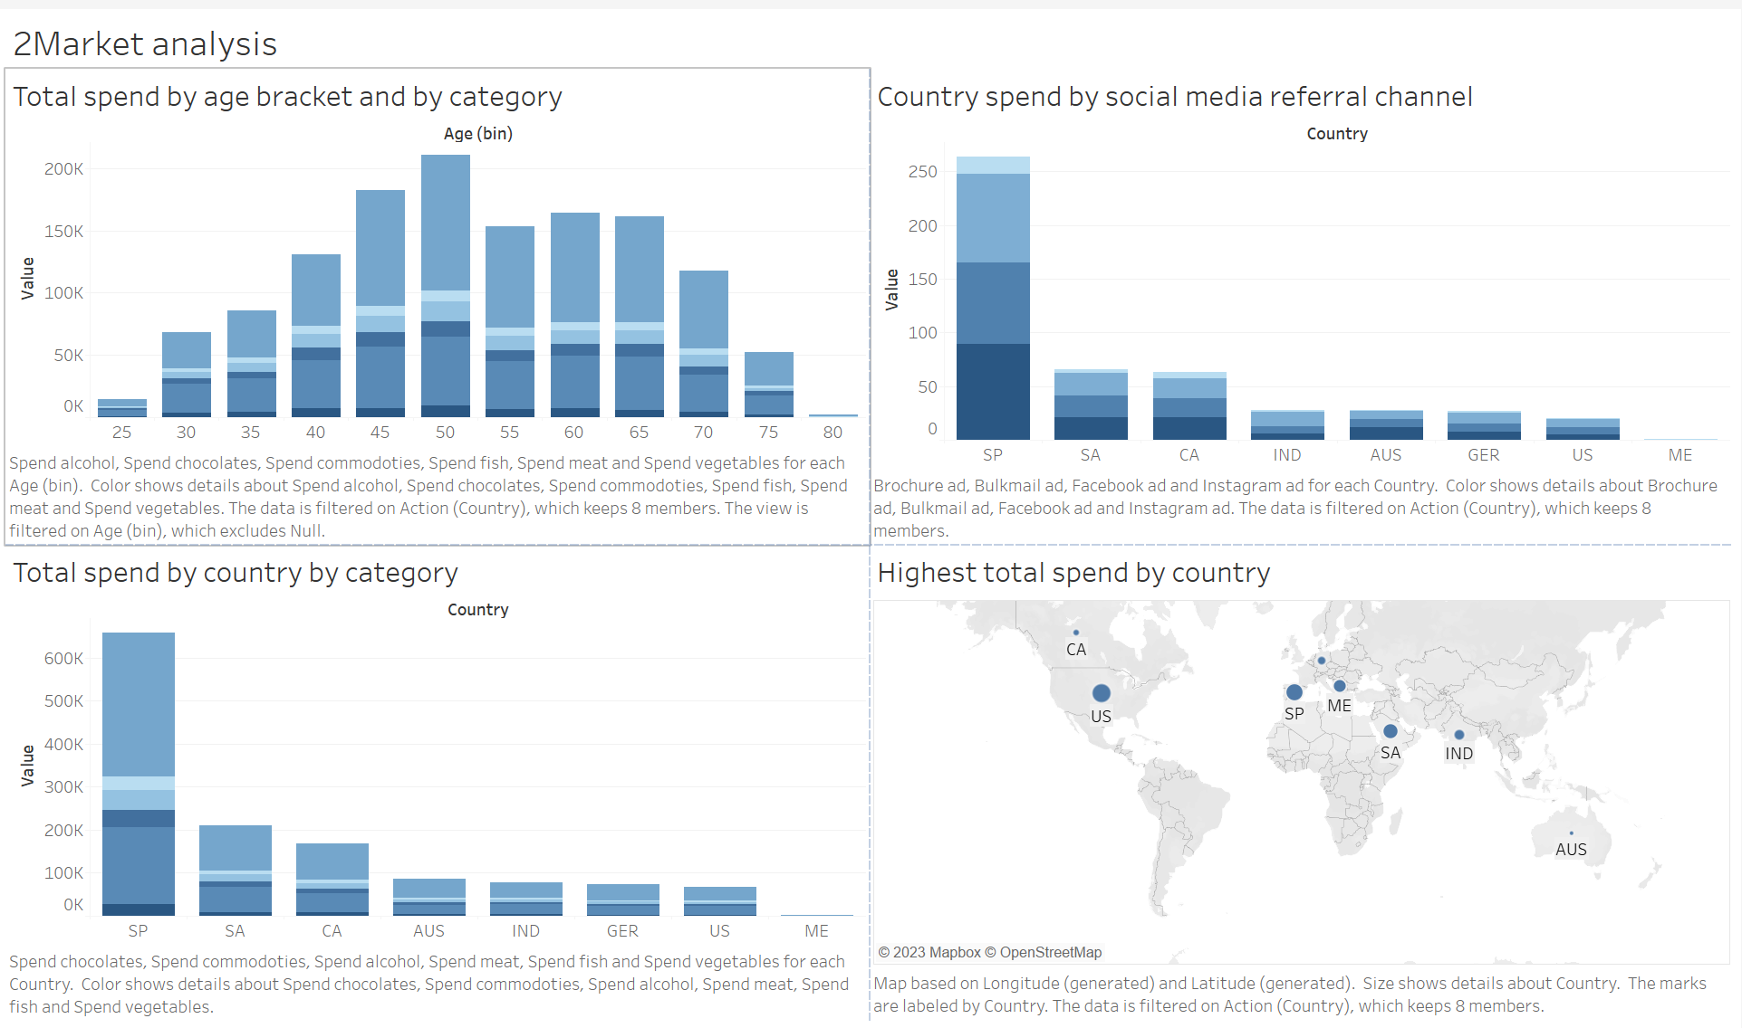
Dashboard usage and accessibility
Only four charts on the dashboard to reduce clutter
Simple colour palette which is consistent across the dashboard for ease of reading
No personal identifiable data has been included in the dashboard
There are no biases are implied based on nationality

Slide 4
Patterns, trends, and insights

Slide 5
Customer demographics 1
The highest average age for customers is found in widowed people
The lowest average age is found in single people
The overall average age is 53

Slide 6
Customer demographics 2
The trend is for income to increase with age
Data has been cleaned to remove one anomalous income value which was 300%x the second highest income value, and three unrealistic dates of birth

Slide 7
Customer demographics 4
Aside from a few outliers shown on this scatter graph, this analysis supports previous findings of income increasing with age
Data has been cleaned to remove one anomalous income value which was 300%x the second highest income value, and three unrealistic dates of birth

Slide 8
Insights – product categories
Alcohol is the most popular product in every country based on unit sales, followed by meat, again in every country
Same as for by country, alcohol is the most popular product for each relationship status, followed by meat by relationship status
Meat becomes the most popular product when they are children or teens in the home; when there are not, the most popular products follows the general trend of being alcohol

Slide 9
Insights – Advertising channels
There is not much variance in number of total purchases driven by online marketing channels; but all online marketing channels outperform brochure referrals for every country
Spain has the most successful rate of social media platform referrals
There are no social media platform referrals in Montenegro
The Married relationship status has the highest rates of social media platform referrals
Facebook is always the least effect social media platform, across all relationship statuses

Slide 10
next steps
Capture more detailed data
Customer demographics:
Capture the full DOB of customers, rather than just the year (or use this data if it had been previously captured)
Capture the ages of all occupants of a household, including the ages of children and teenagers in the household
Purchases:
For all products, capture unit sales details in addition to total amount spent
Have a further breakdown of product details within categories
Marketing:
Capture dates of social media advertising campaigns to compare this to dates of purchases
Capture the details of the campaigns (which categories/ products were advertised)

